Slide 1
Rajshahi University of Engineering and Technology Project on Computer Graphics using OPENGL (CSE 4202)
Course supervisor:
Md. Zahirul Islam
Assistant Professor
Presented by:
Shegufa Rob
1603001

Slide 2
Project Title: A simple simulation of an elevator

Slide 3
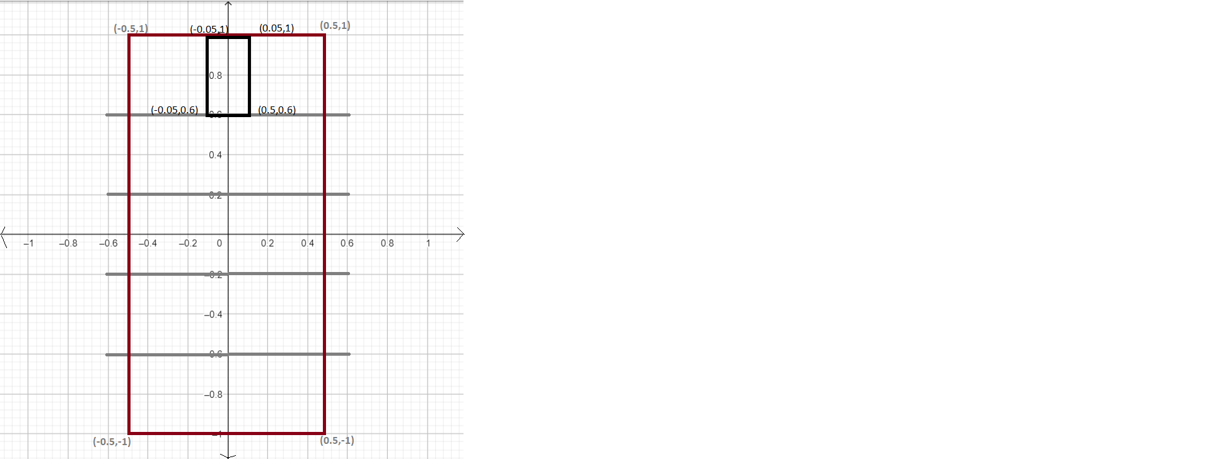
Draft Idea

Slide 4
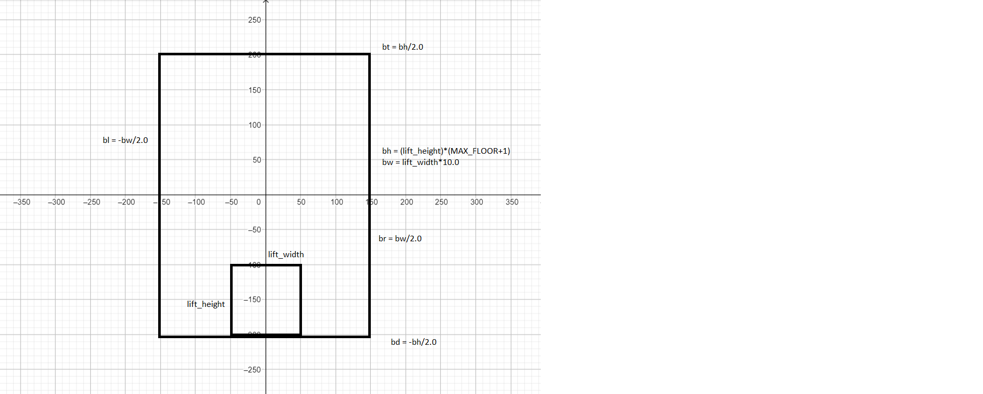
Final Draft Design

Slide 5
Screens
glutKeyboardFunc was used to operate the project.
The project consists of three screens.
First Screen contains the names and course information
If the spacebar is pressed, it will take us to the second page which contains the simulation of the elevator.
Pressing ‘q’ will take us to the end page.

Slide 6
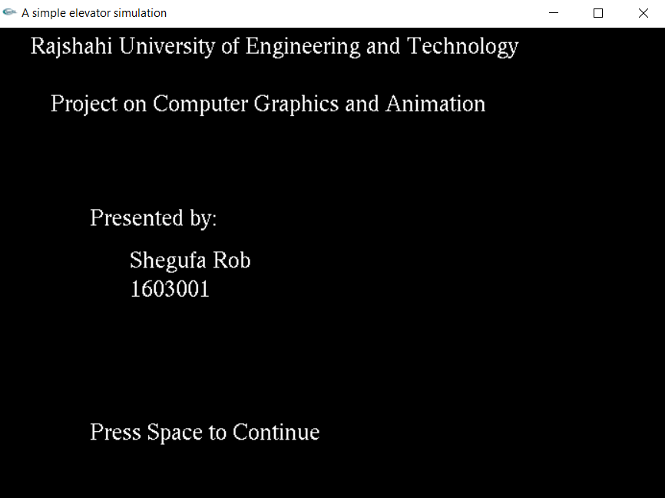
First Screen

Slide 7
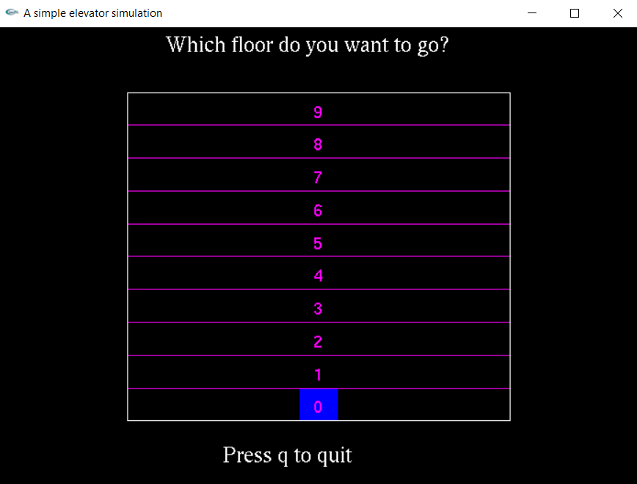
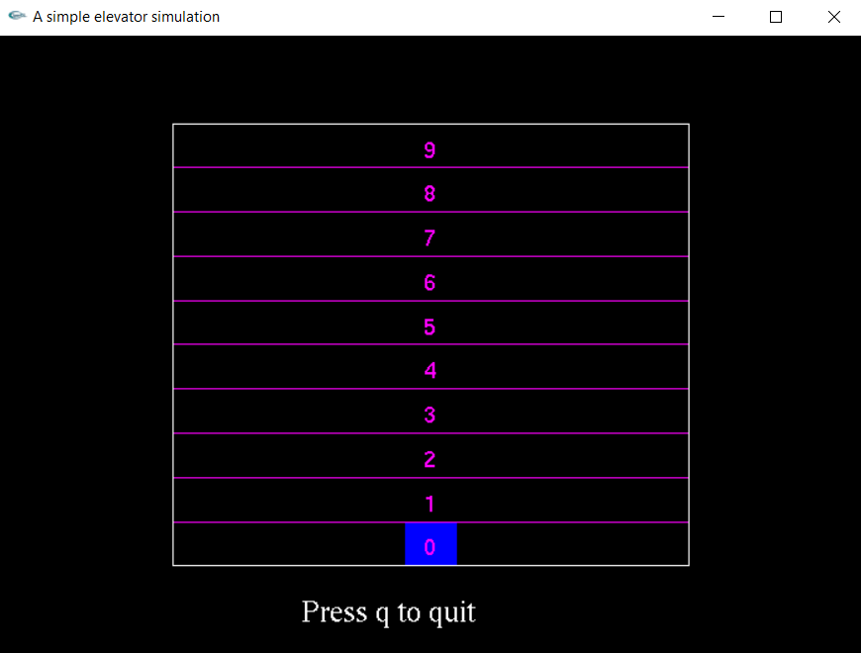
Second Screen

Slide 8
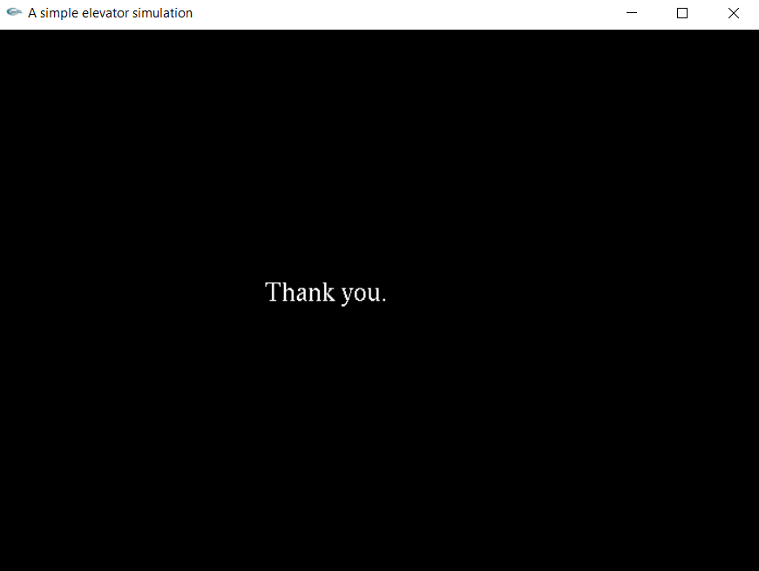
Third Screen

Slide 9
Elevator simulation
The second screen is the main part of our project.
It asks user to enter a floor number
Pressing any floor number will take the lift to that floor.
We can also use up and down arrow keys to move up and down by one floor.
It will stay on this screen until user presses ‘q’.

Slide 10
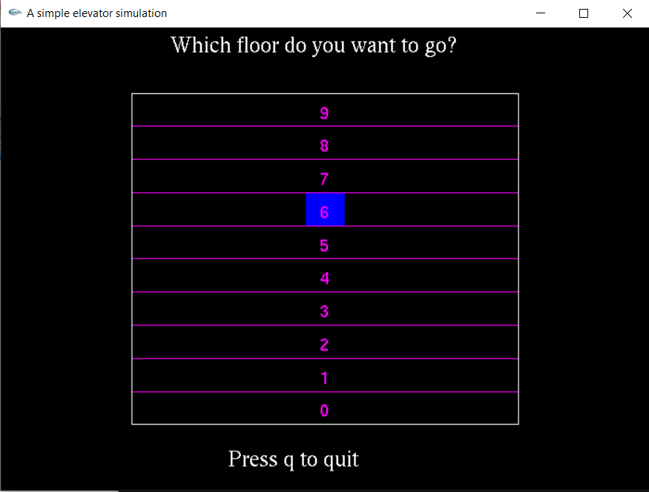
Example
Pressing 6 takes the lift to 6th floor.

Slide 11
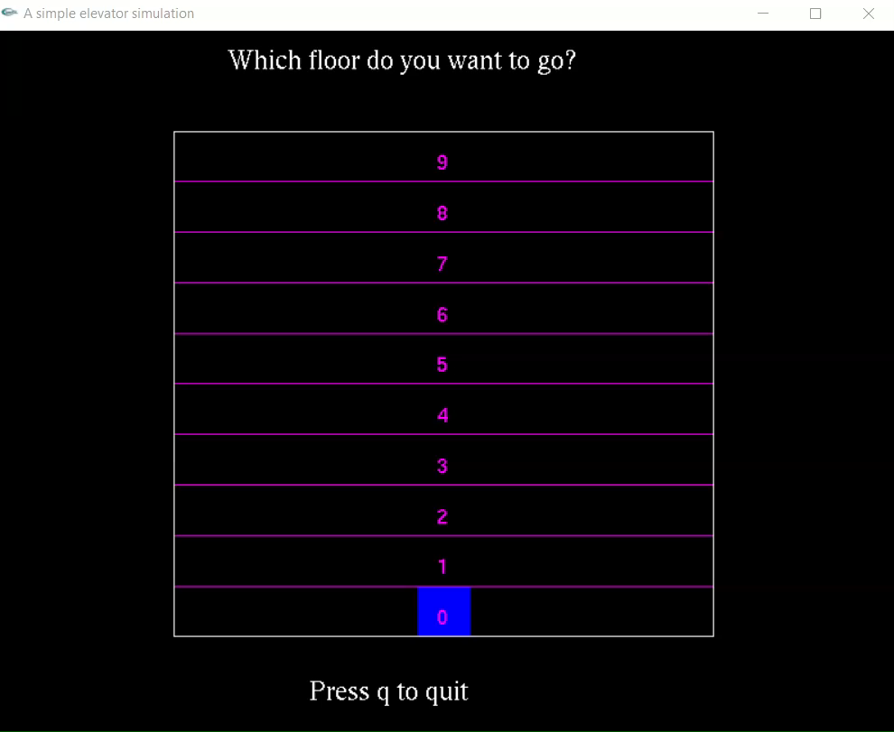
Simulation Video
Key: 5,3,9

Slide 12
THANK YOU

